Slide 1

Precision-Agnostic BLAS/LAPACK and a Modern Linear Algebra API for the Fortran Standard Library
Federico Periniª, Jeremie Vandenplas^{b}, Jose Alvesz^{c}, Ondrej Certik^{d}
ªWisconsin Engine Research Consultants, LLC ^{b}Wageningen University and Research ^{c}Transvalor S.A. ^{d}Microsoft
November 4, 2025

Slide 2
Summary
Reference-LAPACK conversion to modern Fortran
Fortran Standard Library integration
High-level API
Error handling strategy
External library integration
Precision-agnostic implementation

Slide 3
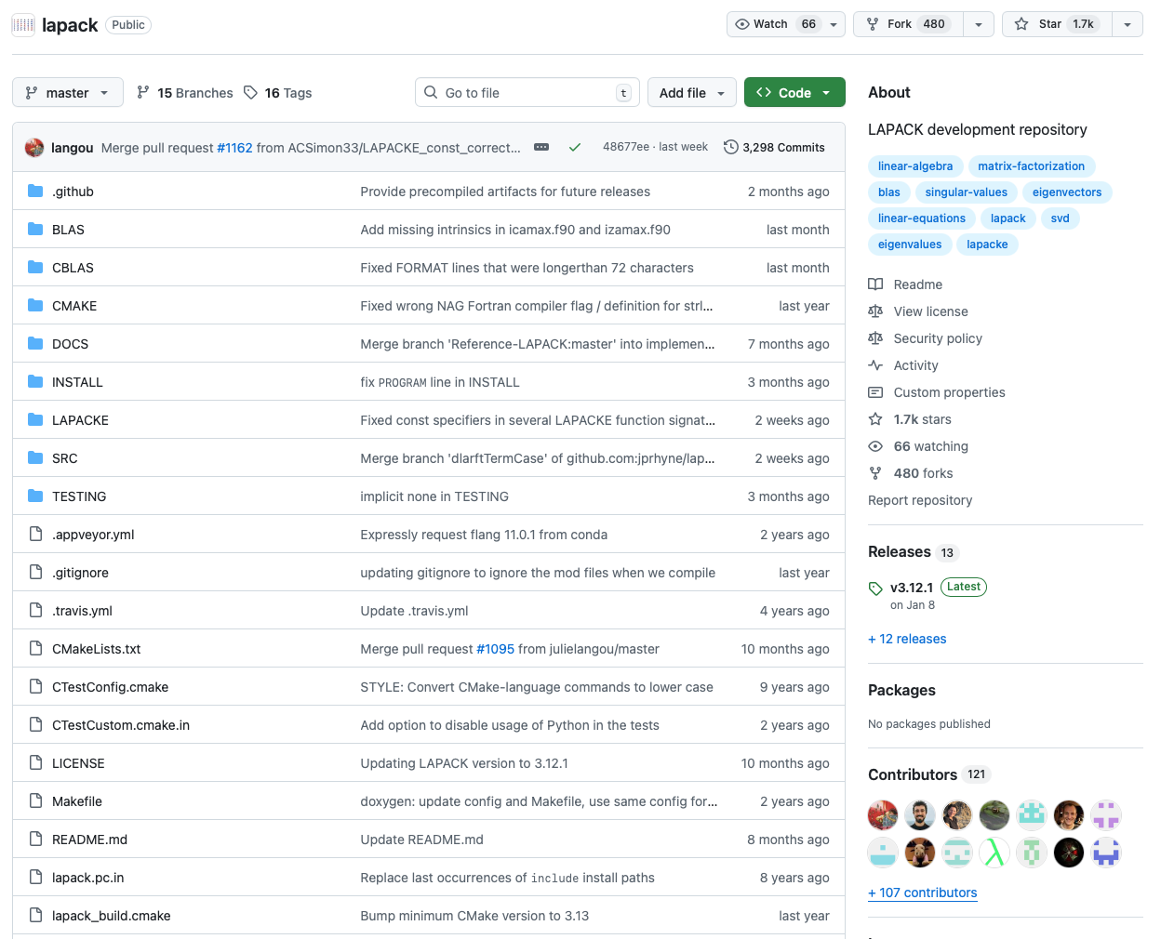
Reference LAPACK in Fortran
✅ Perhaps the most successful library in history of computing. Credits to the authors!
✅ Ubiquitous – the de-facto backend API for non-sparse algebra
✅ Permissive license
✅ Fortran-native
❌ Old-style, mostly FORTRAN 77 ❌ syntax gives Fortran a bad name to the modern unwary observer
❌ No high-level API (NumPy/SciPy)
❌ No integration with Modern Fortran ecosystem (fpm)

Slide 4
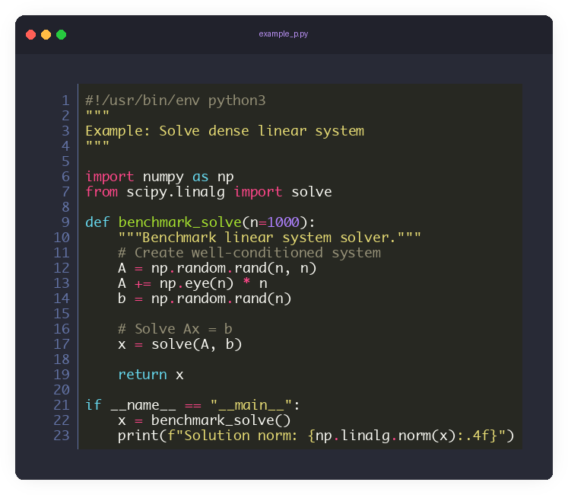
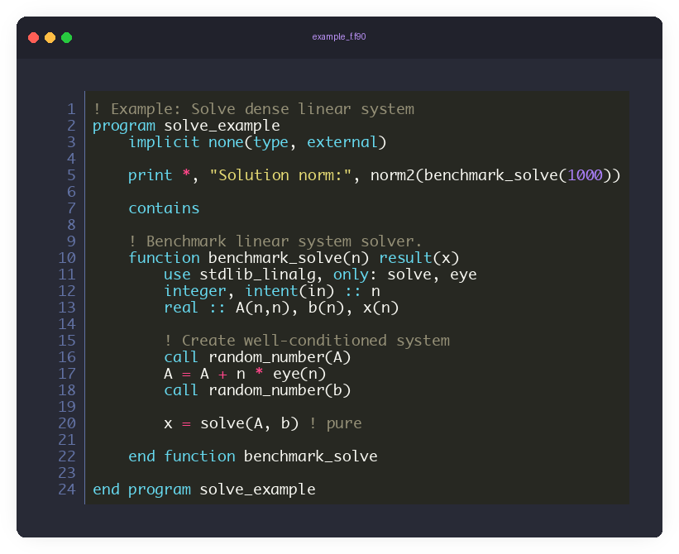
Modernization Goals
To attract newcomers, we should make it easy to write – and run – Fortran.
To retain experts, we must provide state-of-the-art code quality, accuracy, maintenability and performance

Slide 5
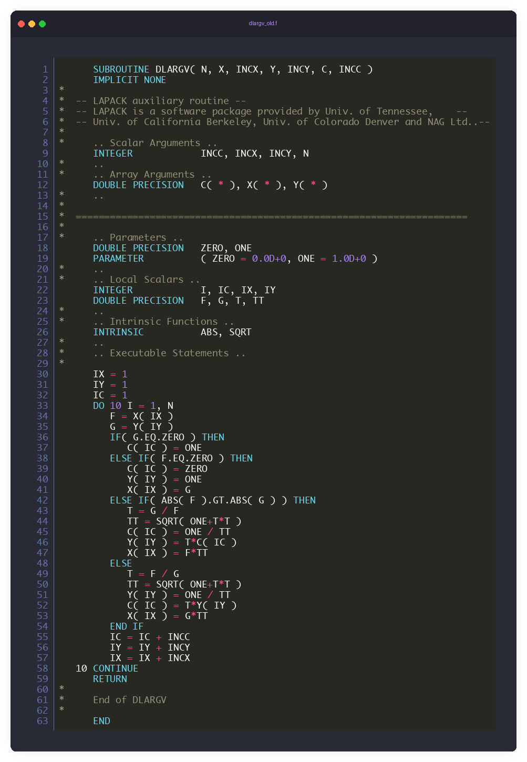
Reference LAPACK Modernization
LAPACK 3.10.1 as the baseline repository
95% automated via Python scripts (“pre-AI” era!)
Available at https://github.com/perazz/fortran-lapack/tree/main/scripts for those interested
Example: Givens rotation parameters
❌ Fixed source file format
❌ Nonportable integer/real precision
❌ Hardcoded parameters
❌ DO/CONTINUE and often GO TO’s
❌ Assumed size arrays

Slide 6
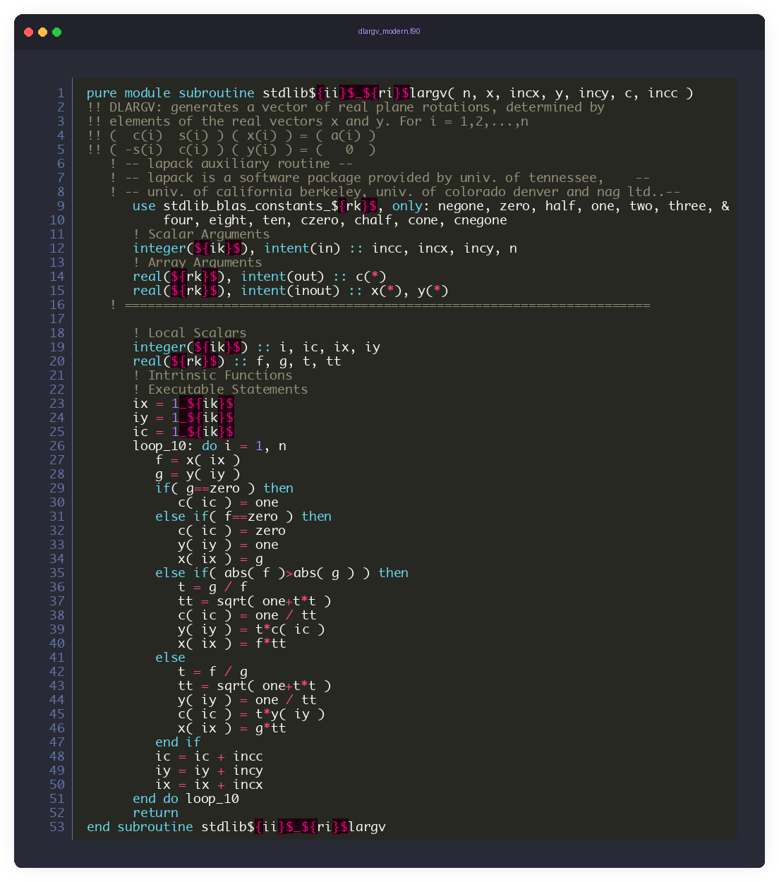
Reference LAPACK Modernization
Modernized: Givens rotation parameters
✅ Procedure is in a module
✅ Intent of all arguments is specified
✅ No side effects? → Made pure
✅ Both real and integer (ilp, ilp64) precision is templated
✅ All numeric parameters templated (fypp) and modularized
✅ Modern loop control via labels / cycle / exit
❌ Assumed size arrays
→ Necessary evil to retain API

Slide 7
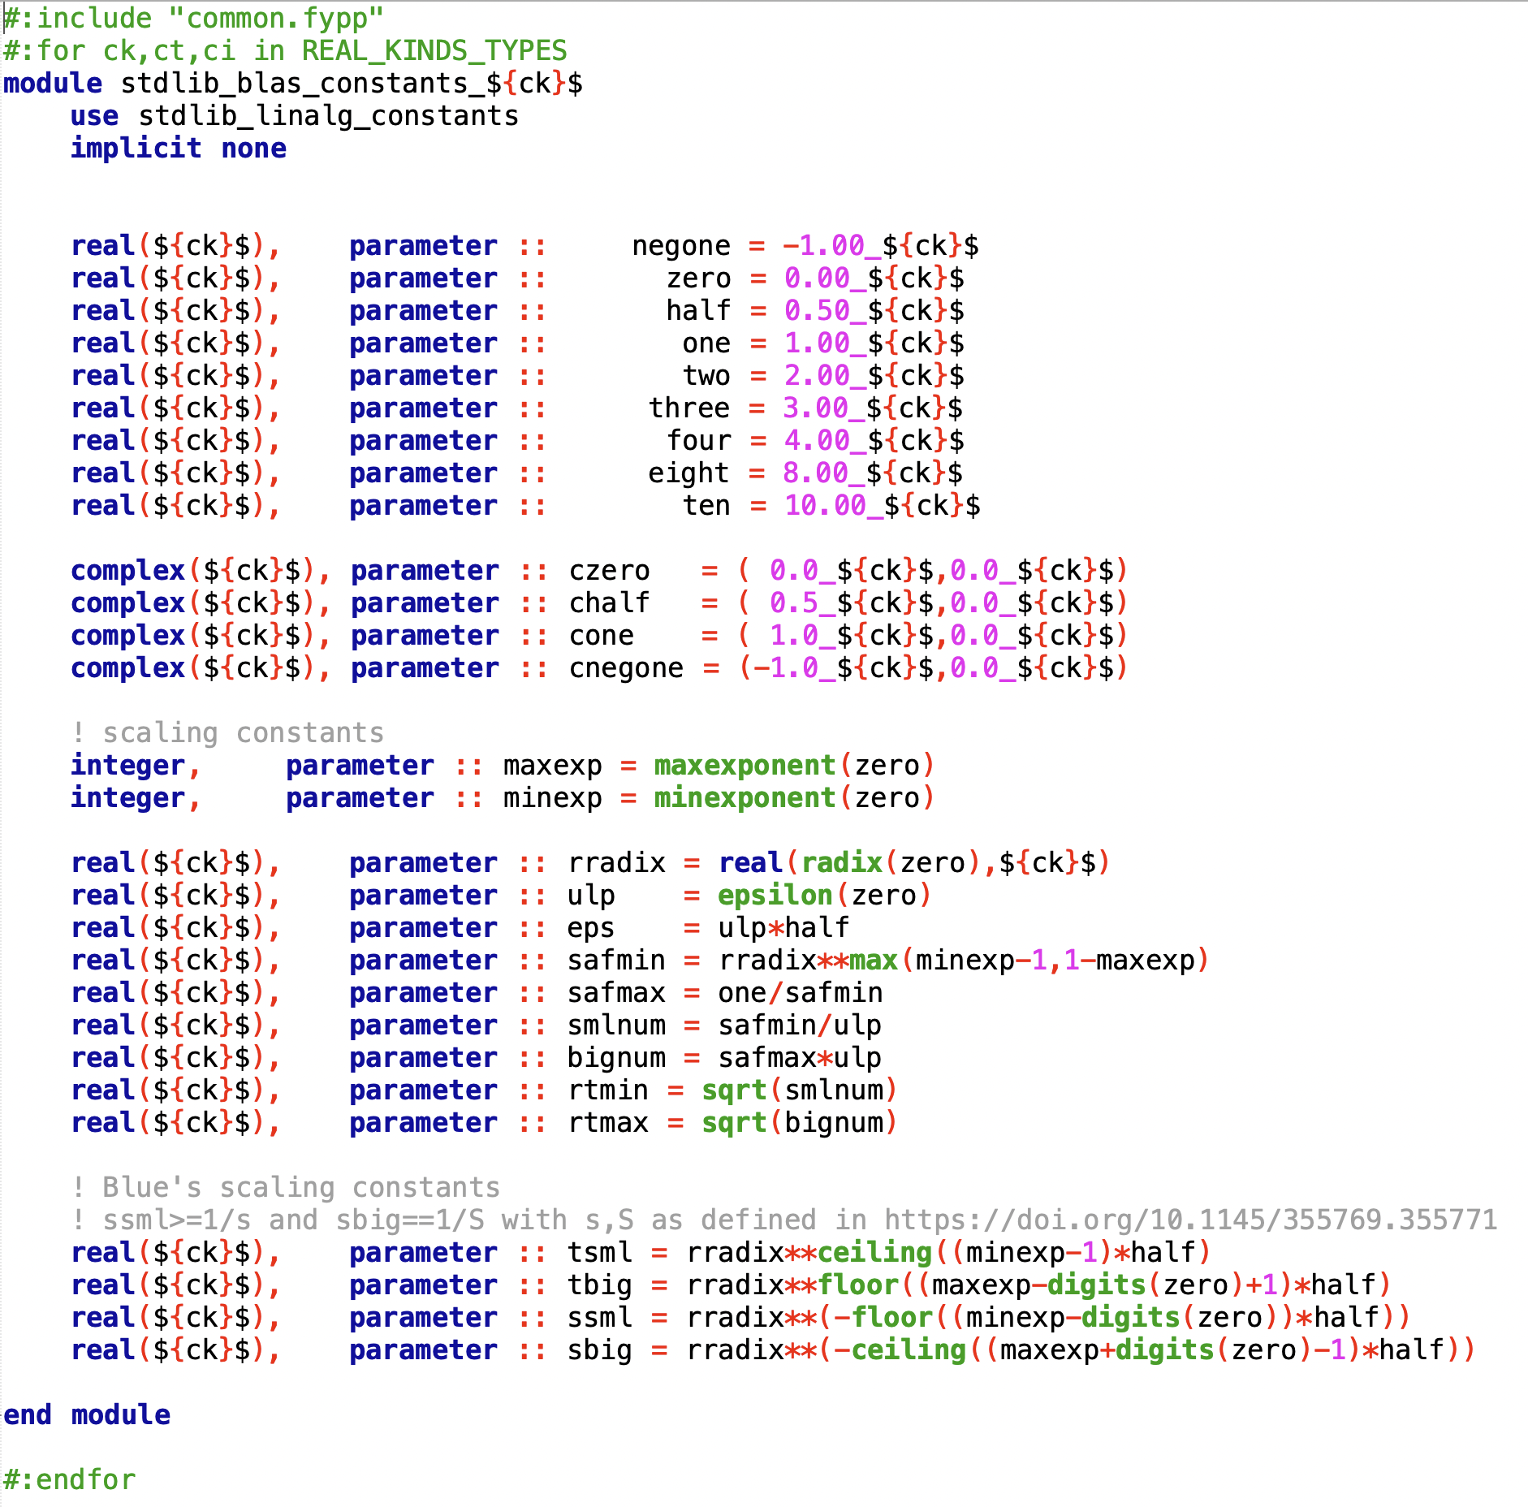
Precision-agnostic details
Fortran intrinsics provide a unique, deterministic way to express floating-point tolerances and scaling constants
Generalized constants have been removed from all procedures and put into stdlib_blas_constants_{prec} modules
Mixed-precision algorithms: “lower-precision” now intended as (i-1)-th
Despite removing all hard-coded scaling constants, tolerances only do not guarantee that the algorithms themselves are not precision-sensitive.

Slide 8
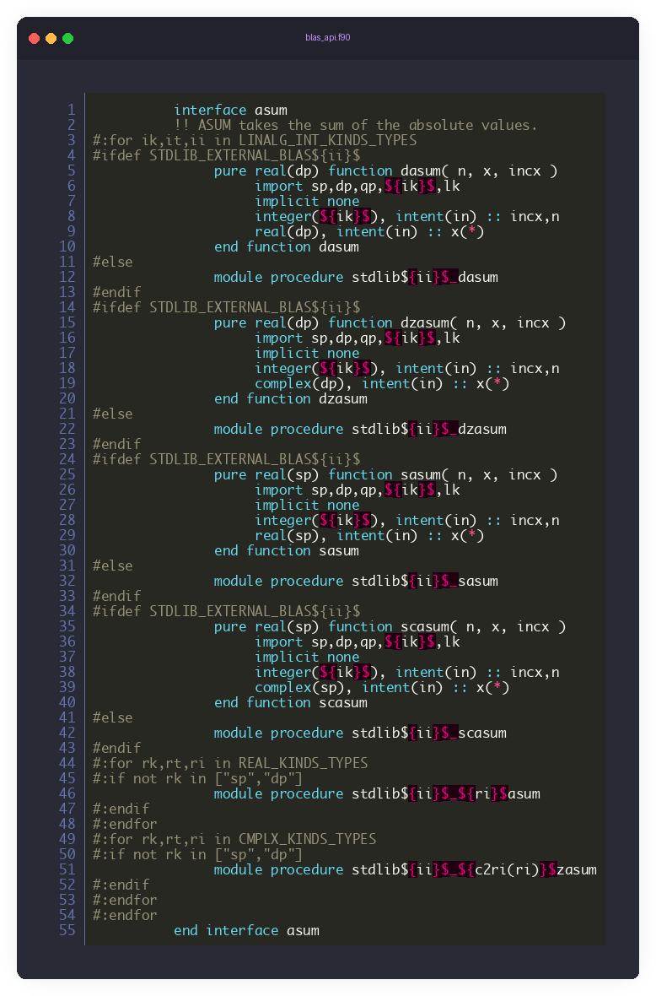
Generalized API
32-64 bit versions good as fallback options; optimized libraries generally available
Generalized API with one-macro switching
! Works for all real/complex precisions y = asum(n, x, incx)
32/64-bit BLAS/LAPACK version can link an external library just by defining macros:
STDLIB_EXTERNAL_BLAS
STDLIB_EXTERNAL_LAPACK → for 32-bit integer size
STDLIB_EXTERNAL_BLAS_I64
STDLIB_EXTERNAL_LAPACK_I64 → for 64-bit integer size
Other precisions ((16-), 80-, 128-bit) and the other integer size are always provided by our modern implementation

Slide 9
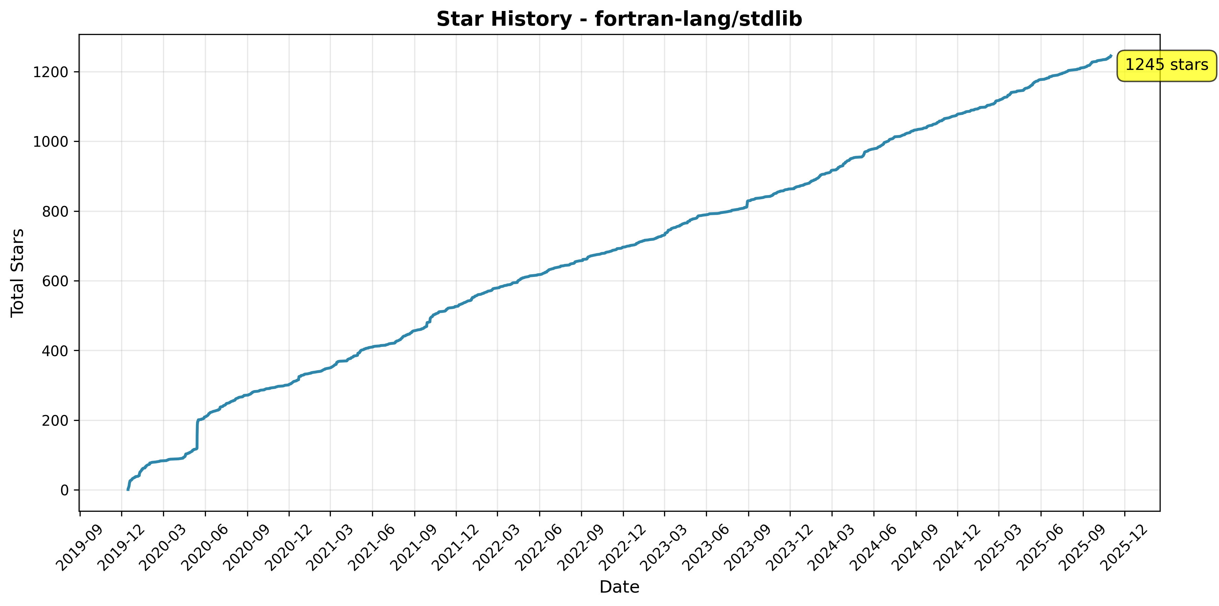
stdlib integration: https://github.com/fortran-lang/stdlib
✅ 8 releases
✅ 62 contributors
✅ >4,000 commits so far
✅ >1,200 GitHub stars
Fortran Standard Library
The Fortran Standard, as published by the ISO (https://wg5-fortran.org/), does not have a Standard Library. The goal of this project is to provide a community driven and agreed upon de facto "standard" library for Fortran, called a Fortran Standard Library (stdlib). We have a rigorous process how stdlib is developed as documented in our Workflow. stdlib is both a specification and a reference implementation. We are cooperating with the Fortran Standards Committee (e.g., the effort started at the J3 committee repository) and the plan is to continue working with the Committee in the future (such as in the step 5. in the Workflow document), so that if the Committee wants to standardize some feature already available in stdlib, it would base it on stdlib's implementation.

Slide 10
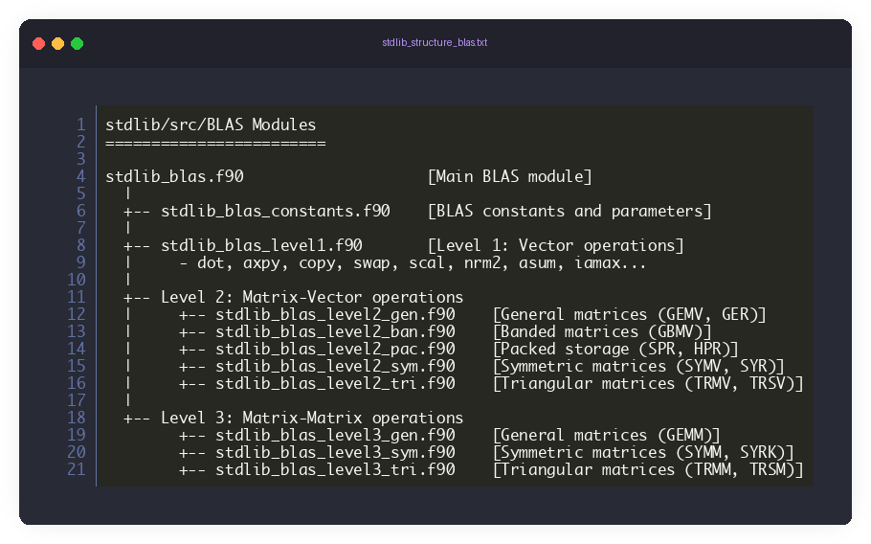
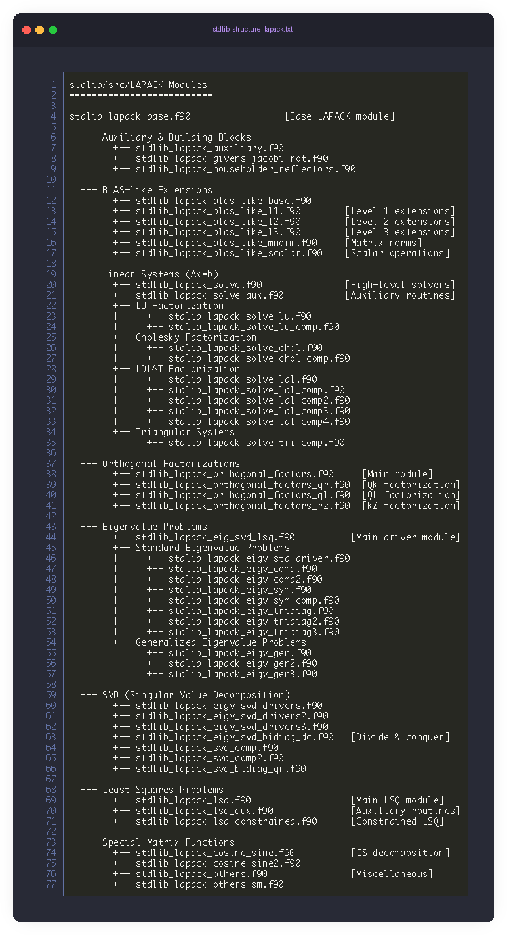
build system optimization
>600,000 LOC modernized
Initially grouped by kind/precision for inlining
Currently grouped by problem classes (precision agnostic)
+
module (API) / submodule (implementation) splitting
➔ Great speed-up in build time: from several minutes, it was reduced to few seconds.
Mac M1 MAX Build Performance summary Cmake, Makefile, gfortran 15.1.0
Fortran Standard Library - Wall Clock Time: 22.86 seconds - Total CPU Time: 133.26 seconds (121.95 user + 11.31 system) - CPU Utilization: ~5.8x (effectively using parallel cores)
BLAS/LAPACK Specific Estimate (~43% of total build)
- Wall clock: ~10 seconds
- CPU time: ~57 seconds

Slide 11
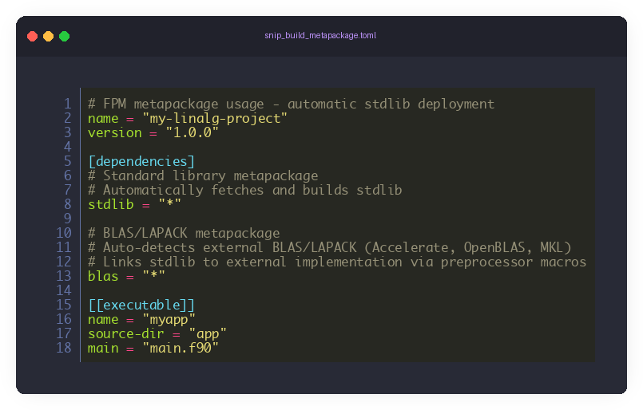
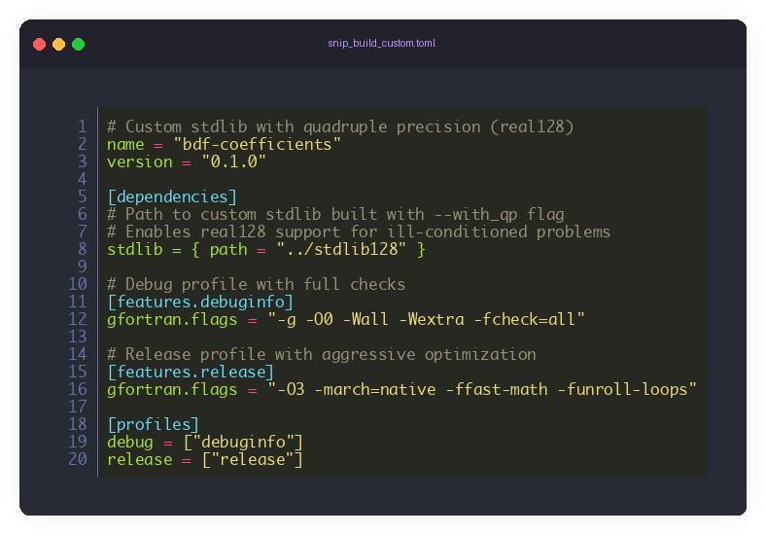
3 build methods
1. CMake (Primary Build System)
Major build method with full customization support
Controls compiler flags, optimization levels, and library linking
Modularized builds in progress: build only specific stdlib components
Industry-standard for large-scale Fortran projects
2. Fortran Package Manager (fpm)
Available via stdlib-fpm and stdlib-fpm-ilp64 branches
Automatically kept up-to-date with each stdlib release
Metapackage support: stdlib = "*" builds standard library
Smart BLAS/LAPACK linking: blas = "*" auto-detects and links external libraries
Macro-based backend selection (internal vs. Accelerate/OpenBLAS/MKL)
3. Python Deployment Script (fypp_deployment.py)
Generate custom FPM-enabled packages with tailored configurations
Control fypp preprocessor macros: --with_qp, --with_xdp, --with_ilp64
Set maximum array rank (default: 4, up to 15)
Enable extended precision: real128 (quadruple), real80 (extended double)
Perfect for specialized applications requiring non-standard features

Slide 12
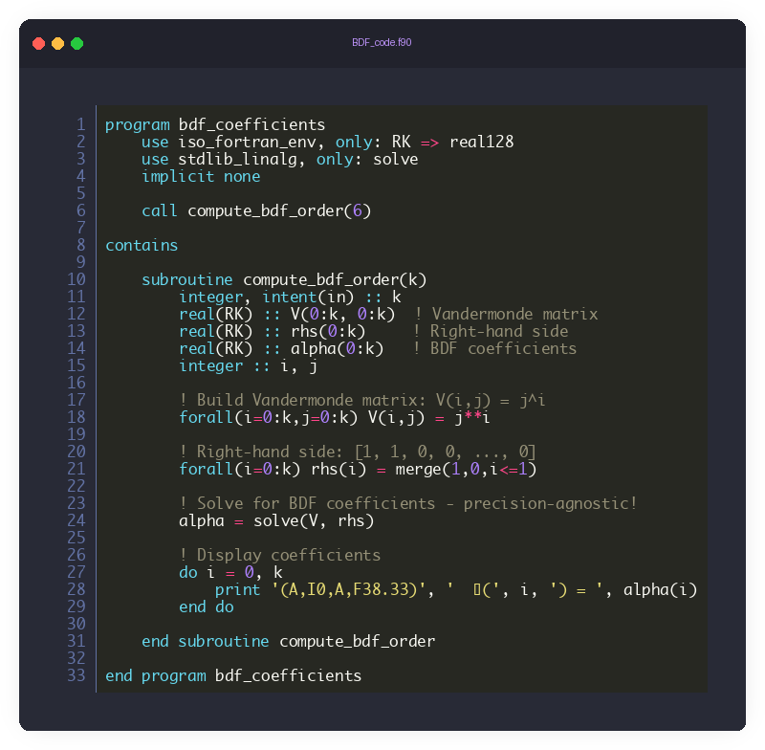
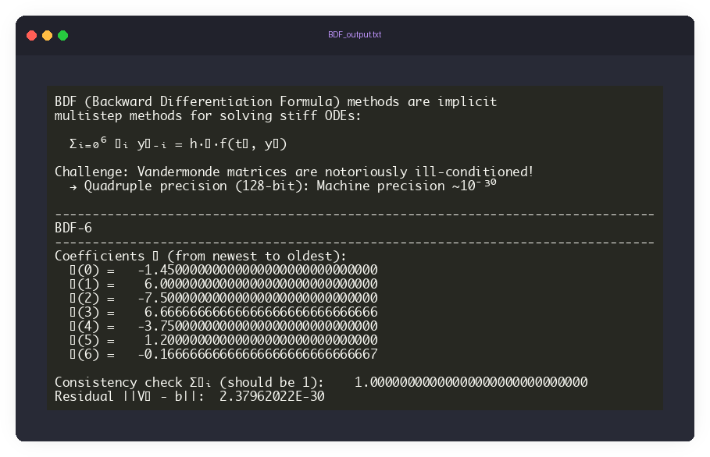
Precision-agnostic example
Backward Differentiation Formulae (BDF) coefficients for order 6 → Quadruple-precision solve
As expected, accuracy of all variables is near 128-bit machine precision

Slide 13
High-level API
Most of us are familiar with high-level syntax from other libraries
Do not reinvent wheel
numpy.linalg
scipy.linalg
Matlab
IMSL FNL (imsl.com)
...
First implementation: mediate among existing APIs
Code Review
Community Input (Fortran Discourse + GitHub)
Fortran Community feedback
Performance should not be compromised → pre-allocated storage → subroutine interfaces
Functional style with pure, elemental interfaces where possible
Retain compatibility with LAPACK API
→ Ease transition from LAPACK to new API
Iterate?

Slide 14
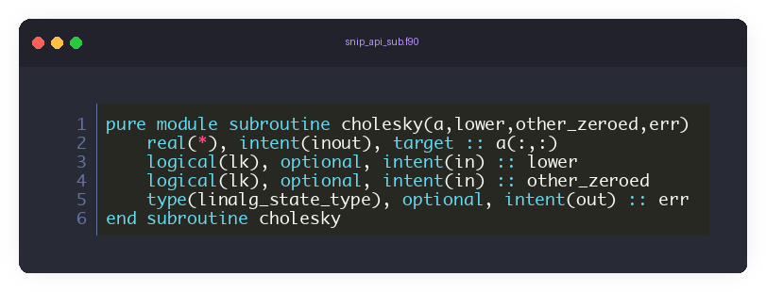
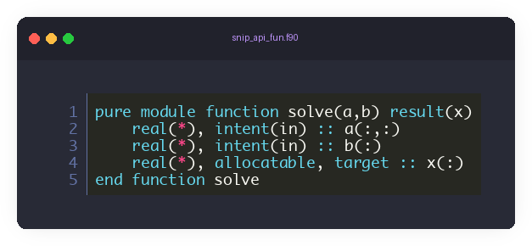
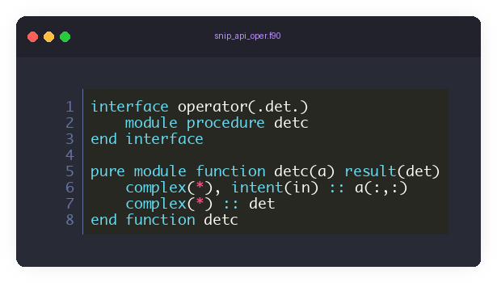
API design
For each operation, we strive to provide 3 possible interfaces:
Subroutine interface ✅ Optional pre-allocated intent(inout) arguments
✅ Pure (where applicable) with optional error control
Functional interface
✅ Pure (where applicable) if no error control ✅ Non-pure if error control
✅ Internal data allocation
.operator. Interface
✅ Highest-level, minimal input arguments
✅ No error control; internal memory handling

Slide 15
Feature-complete API
stdlib now offers a feature-complete, precision-agnostic Linear Algebra API
Some interfaces may still change, but most of them have are stabilized already
Matrix Operations:
eye
diag
trace
outer_product
kronecker_product
cross_product
hermitian
Eigenvalues & Eigenvectors:
eig
eigh
eigvals
eigvalsh
Matrix Properties:
det (.det.)
inv / invert (.inv.)
pinv / pseudoinvert (.pinv.)
Matrix Tests:
is_square
is_diagonal
is_symmetric
is_skew_symmetric
is_hermitian
is_triangular
is_hessenberg
Linear Systems:
solve
solve_lu
solve_lstsq
lstsq
lstsq_space
Decompositions:
chol / cholesky
qr
svd
svdvals
schur
Vector & Matrix Norms:
norm
mnorm
get_norm

Slide 16
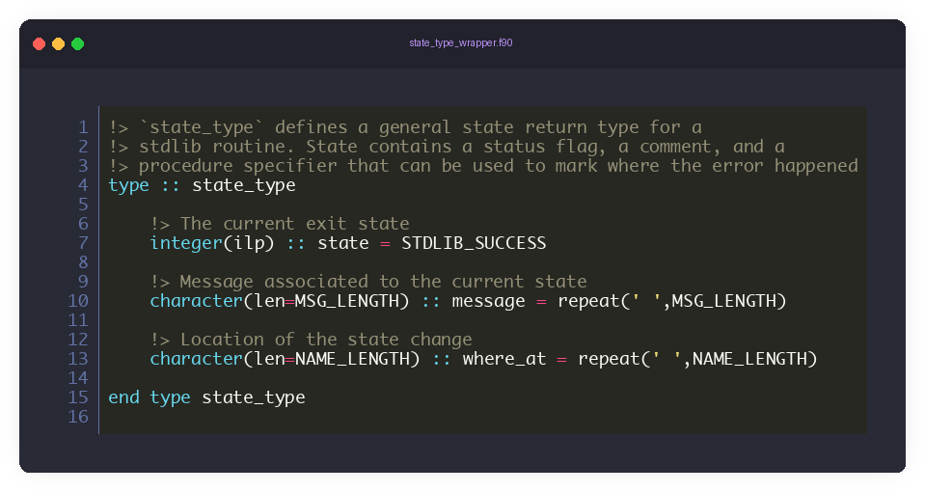
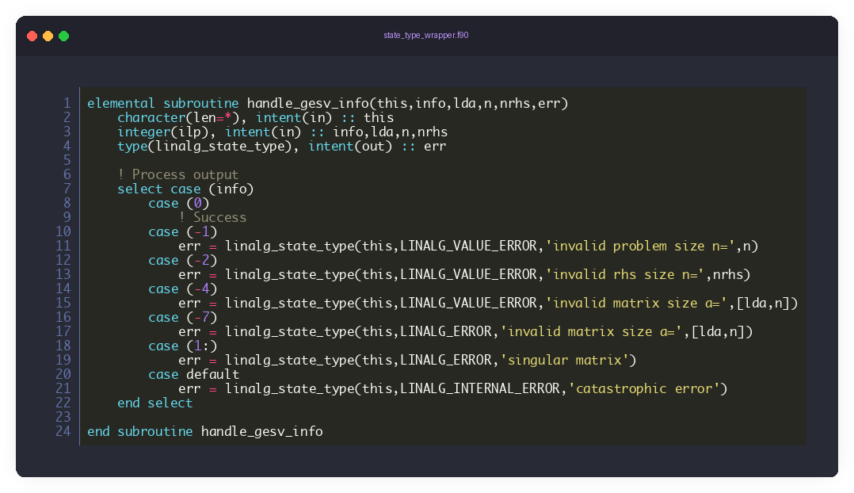
Error Handling
Trade-offs between expressivity and performance
✅ Fixed-size type for fast stack storage
✅ class(*) initializer pretty prints mixed text/data arguments
✅ All procedures enable error control
Subroutines (incl. pure ones)
type(state_type), optional, intent(out) :: err
Return state handler if present
Halt on error if .not. present
Functions → handling via interfaces
A `pure` version with no state output → halt on error
A non-pure version with state output that never halts
.operators. → `pure` → error stop on errors

Slide 17
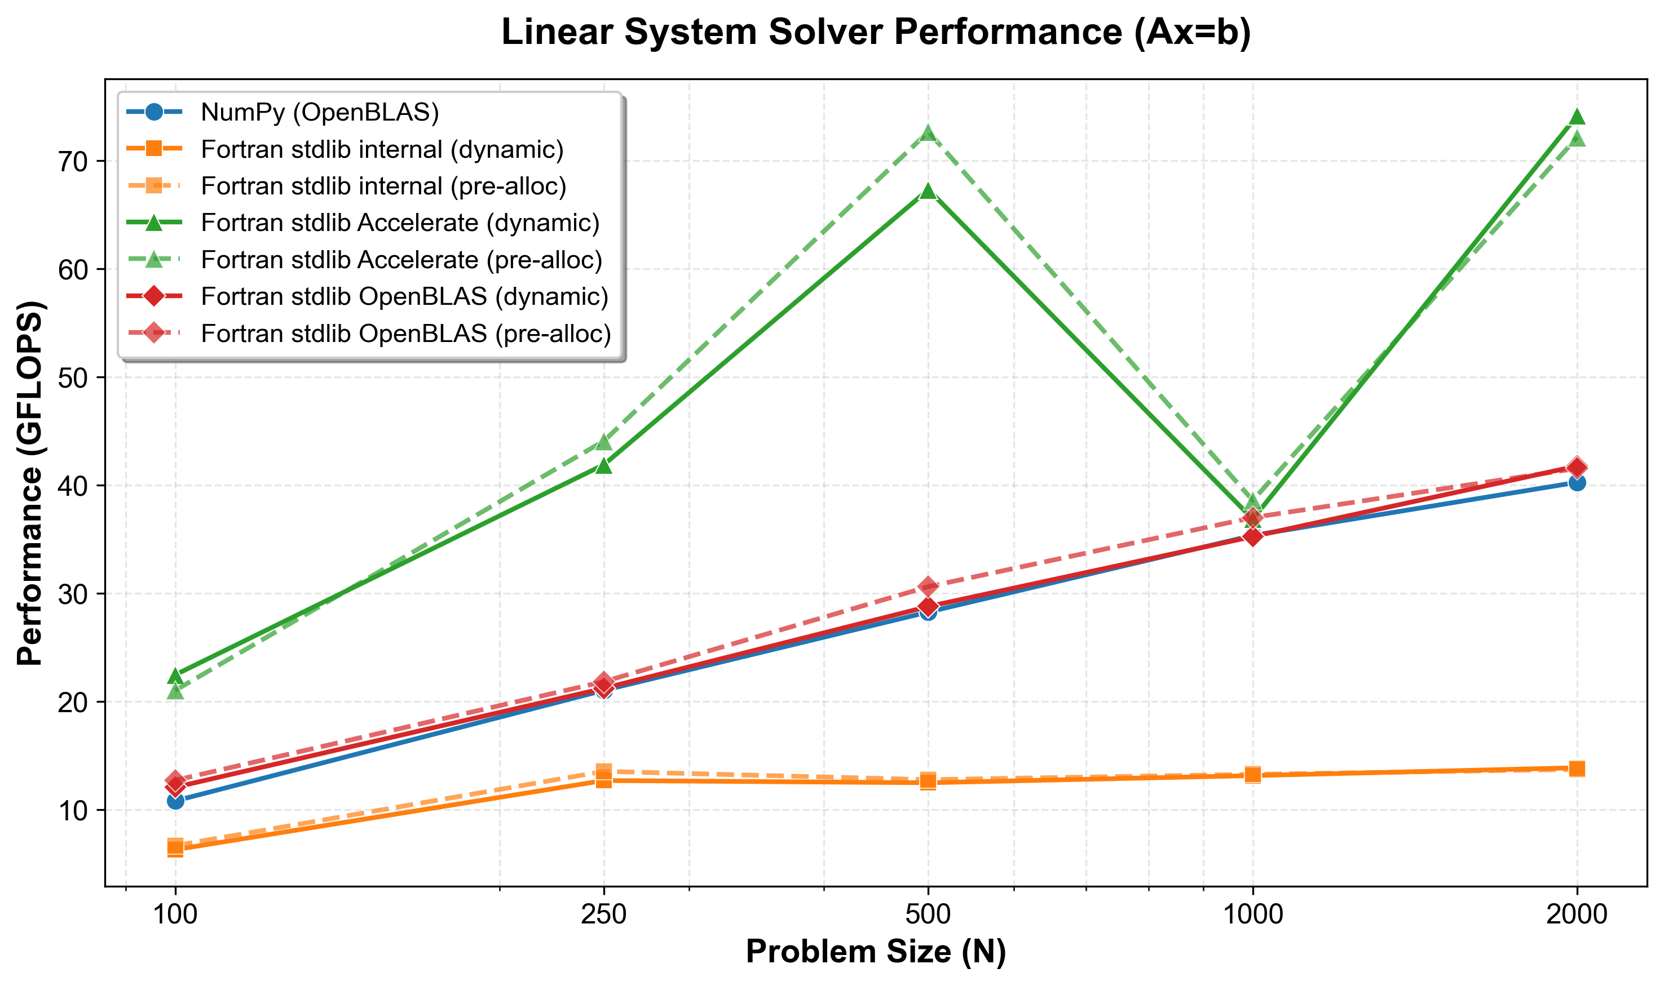
solve: benchmark
10-core Apple M1 MAX w/ 32GB RAM gfortran 15.1.0
Modernized Fortran implementation: -O3 -march=native -ffast-math -funroll-loops -fno-protect-parens
(single-threaded FTW)
External BLAS/LAPACK version: - Apple Accelerate Framework - OpenBLAS 0.3.29 + OpenMP
Python comparison: NumPy solve - OpenBLAS 0.3.29 backend
Benchmark code at https://github.com/perazz/fortran-lapack-examples/benchmarks/solve

Slide 18
Summary
Toward a Thriving Modern Fortran Ecosystem
Recent stdlib Developments
Iterative Solvers, Filesystem, I/O, Advanced Linear Algebra, Improved error handling, do-concurrent optimizations
Recent FPM Developments
Features & Profiles System: conditional compilation, compiler-specific flags, platform targeting; Shared/Static library targets, compile_commands.json; improved compiler support; Enhanced Fortran parsing (interfaces, cpp macros)
🚀 Contribute: github.com/fortran-lang/stdlib
github.com/fortran-lang/fpm
✓ Modernized BLAS/LAPACK
Precision-agnostic: real32, real64, real80, real128, complex
ILP64 support for large-scale computing and MKL compatibility
✓ High-Level API
NumPy/SciPy-inspired syntax with zero overhead
Pure functions, operators, and optional error handling
✓ Excellent Performance
Matches NumPy with external BLAS/LAPACK
Flexible: portable baseline OR optimized backends
✓ Easy Integration
Three build systems: CMake, FPM, Python deployment
One-line dependency: stdlib = "*"

Slide 19
Thank you!
federico.perini@w-erc.com
https://github.com/fortran-lang/stdlib/blob/master/CONTRIBUTING.md

