Slide 1
Practical performance benefits of the fortran PURE keyword in a CFD solver
Paul Bartholomew, Alexei Borissov, Erich Essmann, Sébastien Lemaire, Justs Zarins, Michèle Weiland

Slide 2
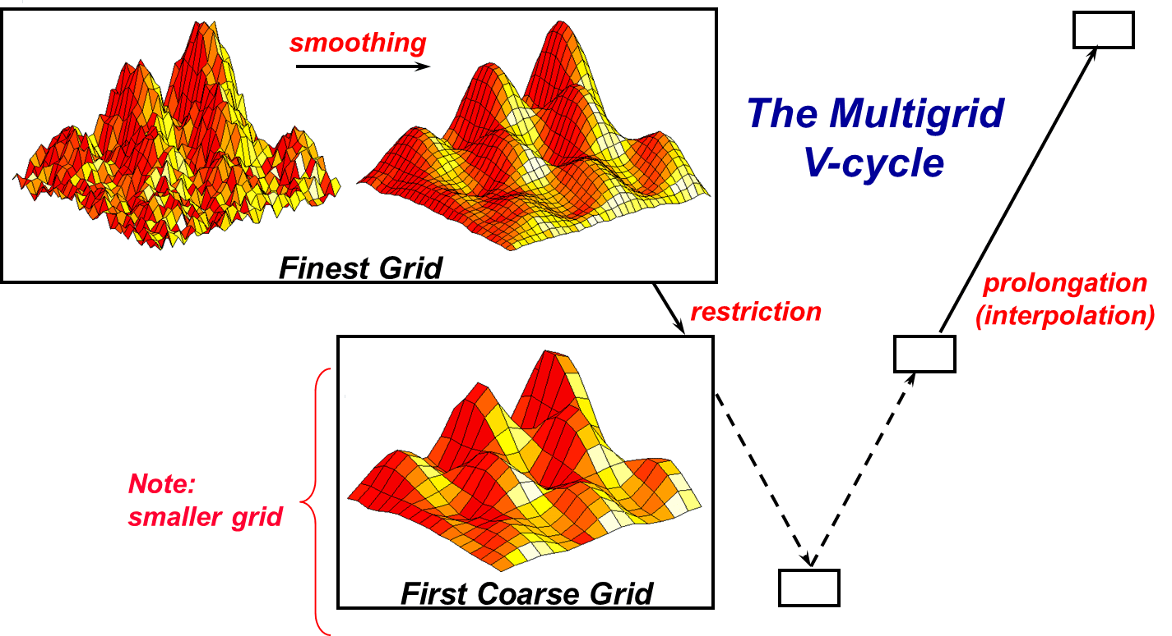
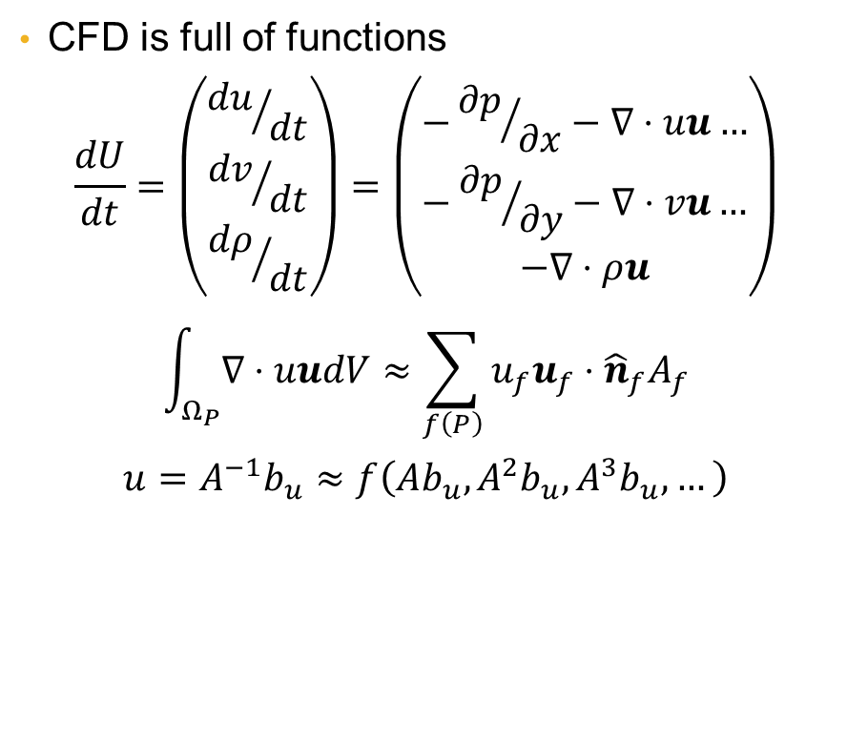
Peeking over the fence
CS must be researching functional programming for a reason
  Haskell
  OCaml
  etc.
CFD is full of functions
$$\frac{dU}{dt}=\left(\begin{matrix}{du}/{dt} \\ {dv}/{dt} \\ {dρ}/{dt}\end{matrix}\right)=\left(\begin{matrix}−{∂p}/{∂x}−∇⋅uu… \\ −{∂p}/{∂y}−∇⋅vu… \\ −∇⋅ρu\end{matrix}\right)$$
$$\int_{Ω_{P}}{∇⋅uudV}≈\sum_{f\left(P\right)}{u_{f}u_{f}⋅{\hat{n}}_{f}A_{f}}$$
$$u=A^{−1}b_{u}≈f\left(Ab_{u},A^{2}b_{u},A^{3}b_{u},…\right)$$
The multigrid cycle. R.Farber; “A new approach in the HYPRE library brings performant GPU-based algebraic multigrid to exascale supercomputers and the general HPC community”; (2021); https://www.exascaleproject.org/highlight/a-new-approach-in-the-hypre-library-brings-performant-gpu-based-algebraic-multigrid-to-exascale-supercomputers-and-the-general-hpc-community/ (Accessed: 14-Oct-2025)

Slide 3
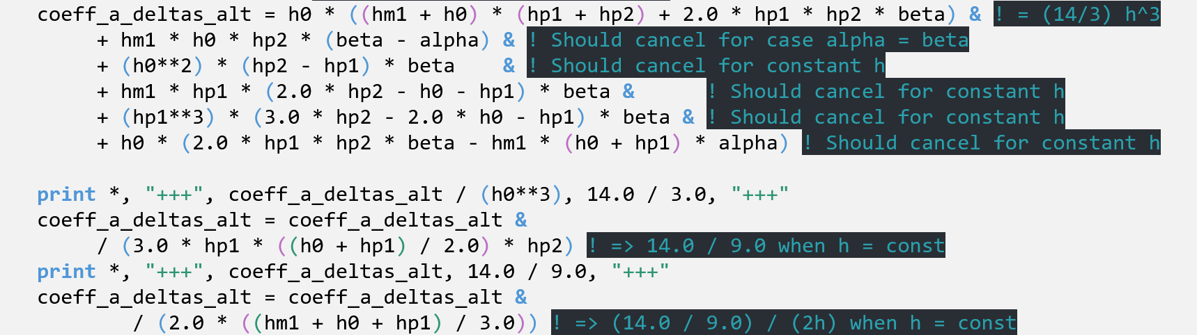
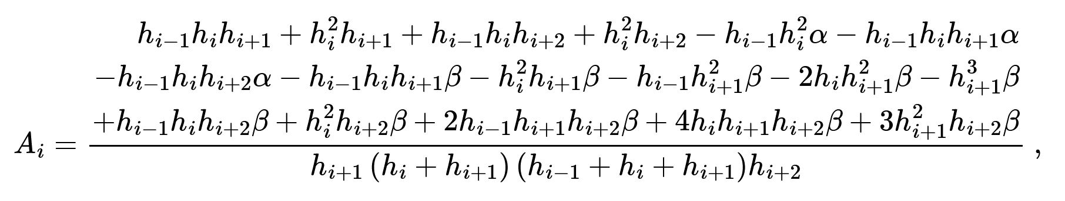
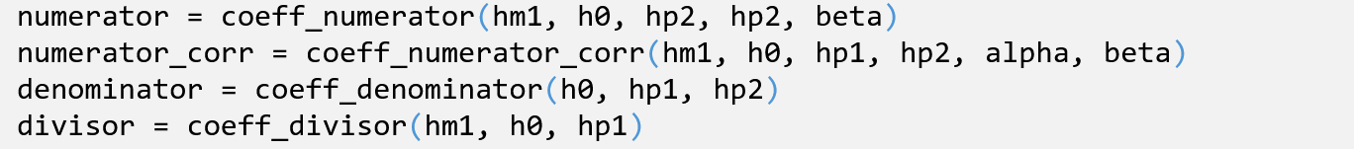
What’s so great about PURE?
Implementing compact finite difference schemes for non-equidistant grids
Expect coefficient to reduce to (known) equidistant value on uniform grids
Surprisingly the test passed!
  Using gfortran...
  Not using ifort or crayftn
  Associativity vs default –O0 or –O2
PRINT to the rescue (deleting PURE)!
Printed values ➔ PURE functions
Easier to read, modify
Testable!
P.Bartholomew; “Better procedure design using the Fortran pure attribute”; https://pbartholomew08.github.io/thoughts/testing_pure_fortran.html (Accessed: 14-Oct-2025)

Slide 4
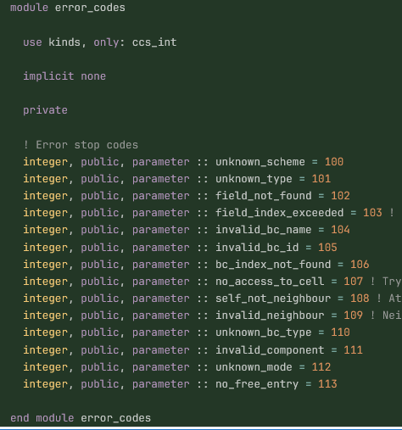
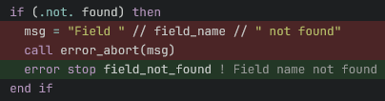
Adding PURE to ASiMoV-CCS
Unstructured CFD code developed as part of the ASiMoV project
  Open source: https://github.com/asimovpp/asimov-ccs
  Development continuing on VECTA project
Written in modern Fortran (F2018)
Extensive use of types, generic interfaces, etc.
  Compiler support has significantly increased recently
Initial development without use of PURE attribute
PURE functions can only call PURE functions
  Required some rewriting of code
    Largely mechanical
  Main issue was error reporting

Slide 5
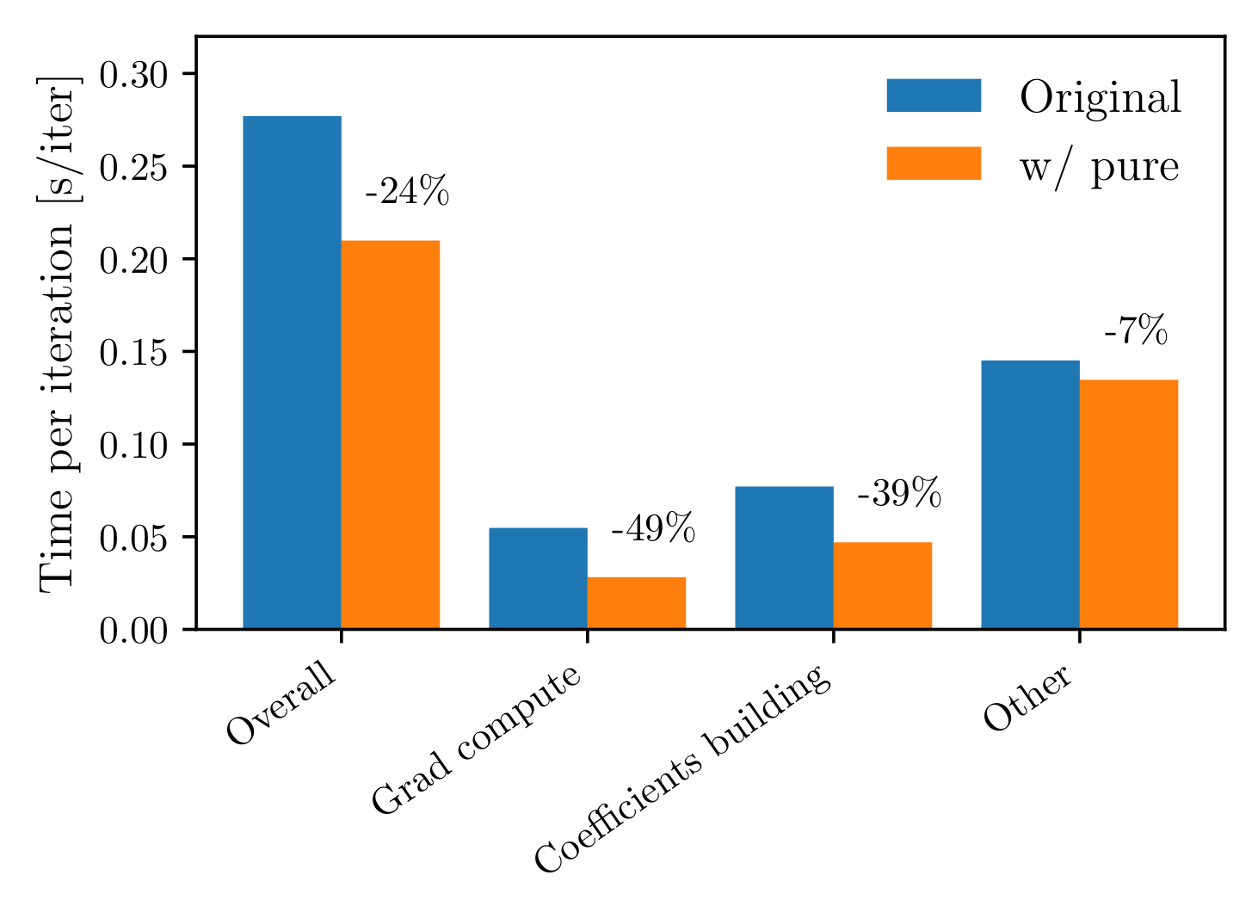
Unexpected results
Aim to improve code quality by “PURE-ifying” ASiMoV-CCS
Found that this gave a sizeable performance improvement
Initial tests performed using crayftn (CCE15) on ARCHER2
Timings breakdown for ASiMoV-CCS pre (Original) and post (w/pure) “PURE-ifying” the codebase.

Slide 6
Is performance due to PURE or PURE rewrite?

Slide 7
Investigating across compilers (solver)

Slide 8
Investigating across compilers (equation assembly)

Slide 9
Conclusions & Future work
Fortran’s PURE statement enforces “better” coding practices
  Compiler-checked > human-checked
Improved code translates into performance improvements
  Performance benefit is portable
  Observed improvement is due to the PURE rewrite, not the PURE statement
Use profiling and optimisation reports to investigate improvement

