Slide 1


State of the FOSS (Fortran Open Source Software)
David Cutting
School of Electronics, Electrical Engineering
and Computer Science
Queen’s University Belfast
d.cutting@qub.ac.uk
https://davecutting.uk

Slide 2
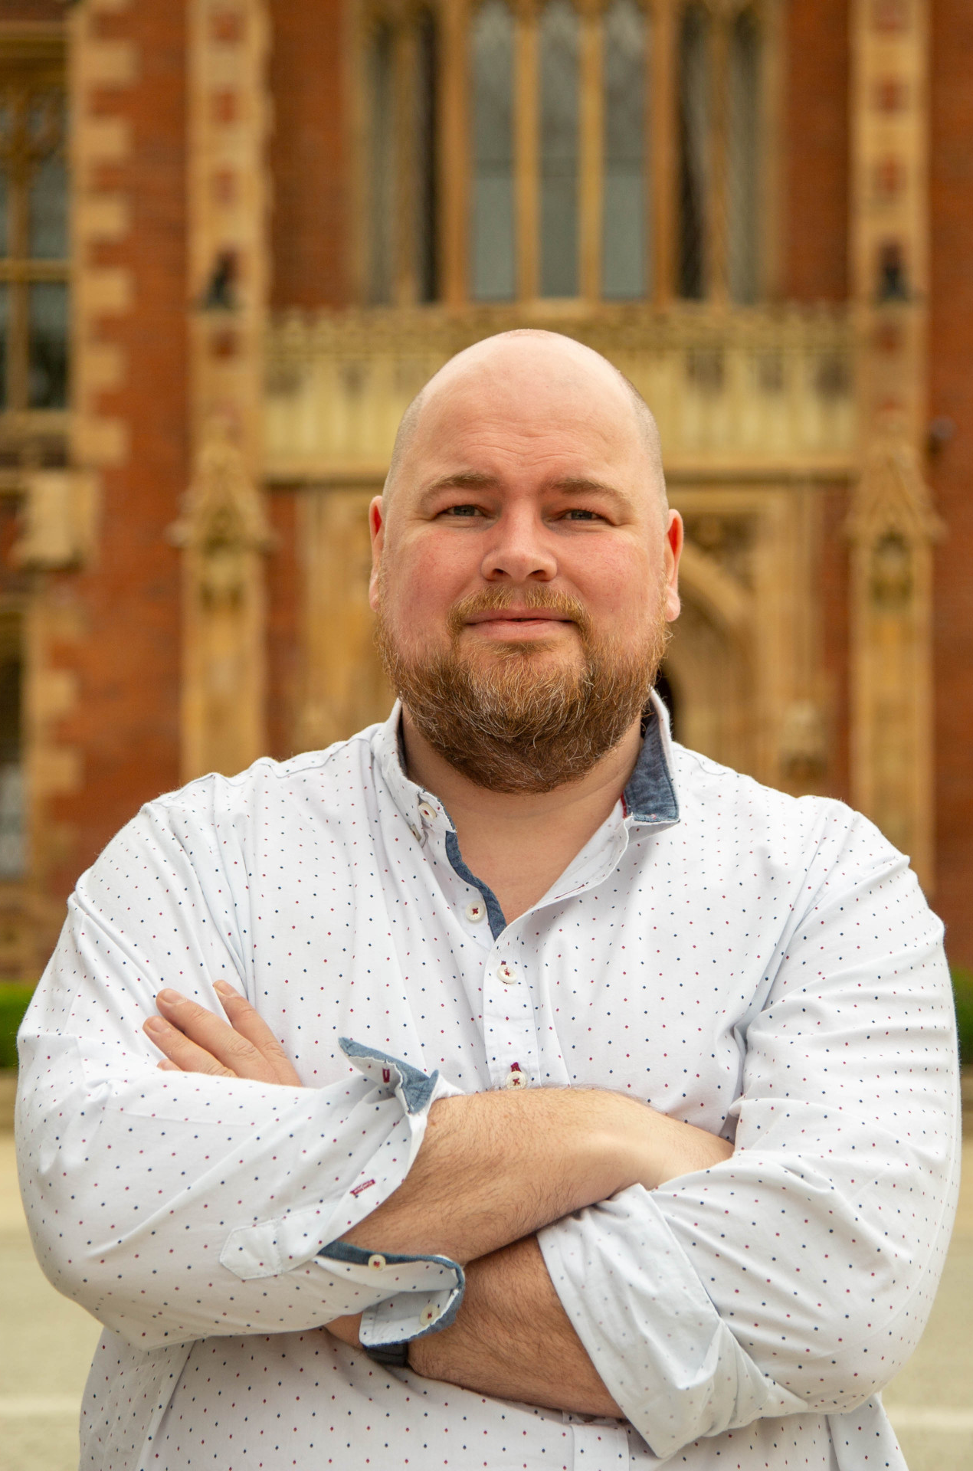
Hello
Reader (Education) in Computer Science / Software Engineering
Research interests in software processes, legacy systems, development practice, refactoring, software quality and computing education (including professional development)
Software fanatic and lazy FOSS developer

Slide 3
COLLABORATORS AND THANKS
Austen Rainer (QUB)
Alexander Nolte (Eindhoven UT and Carnegie Mellon)
Northern Ireland High Performance Computing (NI-HPC)

Slide 4
QUESTION: WHAT THE FOSS?
Can we gain a quick insight into the Fortran open source ecosystem?
Methodology
Mining github
Metadata
Cloning and analysing repositories
Commit history
Combined rudimentary analysis
Warning: this is early quick work and perhaps not as sound as it should could be.
Notes:
Shoreditch.. Dolphin or shark

Slide 5
HEADLINE DATA
Language | Total Repositories | Repositories in Sample | % of Repositories in Sample | Error Rate | Average Stars | Average Watchers | Average Forks | Average Stars per 1000 Repos
Fortran | 40,187 | 1,020 | 2.53813% | 3.82% | 75 | 75 | 32 | 1.87
Python | 21,323,013 | 1,020 | 0.00478% | 4.80% | 19683 | 19683 | 2953 | 0.92
Java | 18,663,261 | 1,020 | 0.00547% | 8.92% | 8946 | 8946 | 2100 | 0.48
COBOL | 6,796 | 1,020 | 15.00883% | 0.59% | 10 | 10 | 2 | 1.47
Go | 1,937,300 | 1,020 | 0.05265% | 3.14% | 11279 | 11279 | 1249 | 5.82
Notes:
For reference only without hiding animation

Slide 6
HEADLINE DATA
Language | Total Repositories | Repositories in Sample | % of Repositories in Sample | Error Rate | Average Stars | Average Watchers | Average Forks | Average Stars per 1000 Repos
Fortran | 40,187 | 1,020 | 2.53813% | 3.82% | 75 | 75 | 32 | 1.87
Python | 21,323,013 | 1,020 | 0.00478% | 4.80% | 19683 | 19683 | 2953 | 0.92
Java | 18,663,261 | 1,020 | 0.00547% | 8.92% | 8946 | 8946 | 2100 | 0.48
COBOL | 6,796 | 1,020 | 15.00883% | 0.59% | 10 | 10 | 2 | 1.47
Go | 1,937,300 | 1,020 | 0.05265% | 3.14% | 11279 | 11279 | 1249 | 5.82

Slide 7
AUTHOR ANALYSIS
Language | Average Authors | % with Multiple Authors
Fortran | 13 | 89.9083%
Python | 60 | 98.9701%
Java | 42 | 98.7083%
COBOL | 2 | 54.0434%
Go | 58 | 99.7976%

Slide 8
COMMIT/HISTORY ANALYSIS
Language | Average Commits per Repo | Average Commits per 1000 Repos | Average Days Between First and Last Commit | Average Days Since Last Commit
Fortran | 1,146 | 28.52 | 2400 | 920
Python | 3,041 | 0.14 | 2080 | 323
Java | 2,310 | 0.12 | 2667 | 924
COBOL | 38 | 5.59 | 286 | 1410
Go | 2,626 | 1.36 | 2627 | 312

Slide 9
LICENCE ANALYSIS
Language | % with Licence | % of Licences FOSS | % of Licences GPL | % of Liecences MIT
Fortran | 80.49% | 69.31% | 26.19% | 21.19%
Python | 94.80% | 82.63% | 9.51% | 33.92%
Java | 86.57% | 86.75% | 7.47% | 14.27%
COBOL | 32.25% | 85.71% | 23.40% | 41.95%
Go | 97.84% | 87.37% | 4.41% | 37.37%

Slide 10
HEADLINE DATA
Language | Total Repositories | Repositories in Sample | % of Repositories in Sample | Error Rate | Average Stars | Average Watchers | Average Forks | Average Stars per 1000 Repos
Fortran | 40,187 | 1,020 | 2.53813% | 3.82% | 75 | 75 | 32 | 1.87
Python | 21,323,013 | 1,020 | 0.00478% | 4.80% | 19683 | 19683 | 2953 | 0.92
Java | 18,663,261 | 1,020 | 0.00547% | 8.92% | 8946 | 8946 | 2100 | 0.48
COBOL | 6,796 | 1,020 | 15.00883% | 0.59% | 10 | 10 | 2 | 1.47
Go | 1,937,300 | 1,020 | 0.05265% | 3.14% | 11279 | 11279 | 1249 | 5.82
Notes:
For reference only without hiding animation

Slide 11
CONCLUSIONS
Fortran shows mixed indicators
When adjusted for sample size some of them are quite positive
There’s more gold in them there repositories, yarr!

Slide 12

Thank You Questions?
Find my socials and contact info below or scan the QR code
d.cutting@qub.ac.uk
https://davecutting.uk

